Slide 1

Oracle Cloud Financials Security
Role Based Access Control (RBAC) Roles Duty Role Abstract Role Job Role Privileges Function Security Privileges Data Security Privileges Users Implementation Users Application Users Roles Provisioning | Security in Cloud Financials General Ledger Security Payables Security Subledger Accounting Security Accounting Hub Security Cash Management Security Assets Security Payments Security BI & OTBI Security

Slide 2
Privileges
Function Security Privileges Function security is a statement of what actions you can perform in which user interface pages including services, screens, and flows, and typically used in control of the main menu. Function Security Privilege is attached to Job Role Secured through Role Based Access Control | Data Security Privileges Data security policies articulate the security requirement "Who can do what on which set of data." Some data security policies are not defined as grants but directly in applications code. Data Security Privilege is attached to Job Role Secured through Role Based Access Control

Slide 3
Users
Implementation Users The initial user can perform all the necessary setup tasks and can also perform security tasks Implementation Users should have couple of Job Roles: Application Implementation Consultant, IT Security Manager and can have abstract role: Employee or Manager Ideally created from Security Console | Application Users Meant for the purpose of using the application and perform transactions Application Users should have Abstract Roles either Employee, Manager etc. Ideally created from Navigator > My Team > Manage Users

Slide 4
Creating Implementation Users
Steps | Task or Activity | Description
1 | Create Implementation Users | The Application Implementation Consultant user may be your only implementation user.However, you can create the implementation users TechAdmin and ERPUser, and assign the required job roles to them if you need these implementation users and they don't already exist in your environment.
2 | Run User and Roles Synchronization Process | Run the process Retrieve Latest LDAP Changes to copy changes to users and their assigned roles to Oracle Fusion HCM
3 | Assign Security Profiles to Abstract Roles | Enable basic data access for the predefined Employee, Contingent Worker, and Line Manager abstract roles.
4 | Create a Generic Role Mapping for the Roles | Enable the roles created in step 3 to be provisioned to implementation users.
5 | Assign Abstract Role and Data Access to the Implementation User | Assign the implementation user with the roles that enable functional implementation to proceed.
6 | Verify Implementation User Access | Confirm that the implementation user can access the functions enabled by the assigned roles.

Slide 5

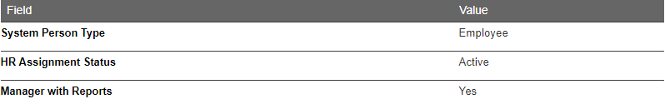
Role Provisioning
Case 1:
Role Assigned:
Employee
Case 2:
Role Assigned:
Manager

Slide 6
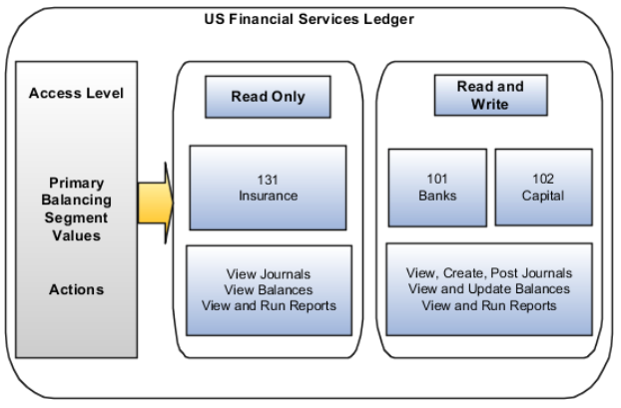
General Ledger Security
Function Security
Job Roles
General Accounting Manager
General Accountant
Financial Analyst
Data Security
Data Access Set
Segment Value Security Rules

Slide 7
Payables Security
Function Security
Job Roles
Edit Access to Document Repository
Accounts Payable Manager
Accounts Payable Specialist
Accounts Payable Supervisor
View Only Access to Document Repository
Financial Application Administrator
Cost Accountant
Project Accountant
Data Security
Secure Access Based on Business Unit
Invoices
Payments

Slide 8
Subledger Accounting Security
SubLedger Accounting Security
Function Security & Data Security
Setup Task Security
Security to configure accounting rules to define accounting treatments for transactions.
Roles Required
Financial Application Administrator job role(Subledger Accounting Administration duty role)
Transactional Task Security
Security to create subledger journal entries
Security to review and generate reports of subledger journal entry headers and lines

Slide 9
Subledger Accounting Security(Contd...)
Accounting Hub Security
Function Security & Data Security
Setup Task Security
Security to register source systems into Accounting Hub.
Security to configure accounting rules to define accounting treatments for transactions.
Roles Required
Financial Application Administrator job role(Accounting Hub Administration duty role)
Role with following Duty Role
Application Implementation Consultant
Accounting Hub Integration
Transactional Task Security
Security to create subledger journal entries
Security to review and generate reports of subledger journal entry headers and lines
Roles Required
General Accounting Manager Job Role with following Duty Role
Accounting Hub Integration
Chief Financial Officer or General Accountant with following Duty Role
Subledger Accounting Duty
Subledger Accounting Reporting

Slide 10
Cash Management Security
Assign unique GL Cash Account each account
Grant Bank Account Security
Bank Account Use Security
Application for which Account is created for
Bank Account Access Security
Grant access to One or More Business Unit
Define appropriate Use for the Application
Roles Required
Cash Manager Job Role (Cash Management Administrator Duty Role)

Slide 11
Assets Security
Asset Activities are secured by Data Privileges
Data Privileges are for the following Asset Activities:
Add Fixed Asset Data
Change Fixed Asset Data
Retire Fixed Asset Data
Track Fixed Asset Data
Submit Fixed Asset Reports
Asset Book Security Context

Slide 12
Payments Security
Use of System Security Options
Implementation of Master Encryption Key
Credit Card Tokenization
Encrypt
Credit Card Data
Bank Account Data
Payment Instrument Data
Mask
Credit Card Data
Bank Account Data
Payment Instrument Data

Slide 13
BI & OTBI Security
Will be discussed as part of BI & OTBI Lessons

